Slide 1
Creating Packages

Slide 2
Objectives
After completing this lesson, you should be able to do the following:
  Describe packages and list their components
  Create a package to group together related variables, cursors, constants, exceptions, procedures, and functions
  Designate a package construct as either public or private
  Invoke a package construct
  Describe the use of a bodiless package
Notes:
Oracle Database 11g: Develop PL/SQL Program Units 3 - <number>
Lesson Aim
In this lesson, you learn what a package is and what its components are. You also learn how to create and use packages.

Slide 3
Lesson Agenda
  Identifying the benefits and the components of packages
  Working with packages:
    Creating the package specification and body
    Invoking the package subprograms
    Removing a package
    Displaying the package information
Notes:
Oracle Database 11g: Develop PL/SQL Program Units 3 - <number>

Slide 4
What Are PL/SQL Packages?
  A package is a schema object that groups logically related PL/SQL types, variables, and subprograms.
  Packages usually have two parts:
    A specification (spec)
    A body
  The specification is the interface to the package. It declares the types, variables, constants, exceptions, cursors, and subprograms that can be referenced from outside the package.
  The body defines the queries for the cursors and the code for the subprograms.
  Enable the Oracle server to read multiple objects into memory at once.
Notes:
Oracle Database 11g: Develop PL/SQL Program Units 3 - <number>
PL/SQL Packages: Overview
PL/SQL packages enable you to bundle related PL/SQL types, variables, data structures, exceptions, and subprograms into one container. For example, a Human Resources package can contain hiring and firing procedures, commission and bonus functions, and tax exemption variables.
A package usually consists of two parts stored separately in the database:
A specification
A body (optional)
The package itself cannot be called, parameterized, or nested. After writing and compiling, the contents can be shared with many applications.
When a PL/SQL-packaged construct is referenced for the first time, the whole package is loaded into memory. Subsequent access to constructs in the same package does not require disk input/output (I/O).

Slide 5
Advantages of Using Packages
  Modularity: Encapsulating related constructs
  Easier maintenance: Keeping logically related functionality together
  Easier application design: Coding and compiling the specification and body separately
  Hiding information:
    Only the declarations in the package specification are visible and accessible to applications
    Private constructs in the package body are hidden and inaccessible
    All coding is hidden in the package body
Notes:
Oracle Database 11g: Develop PL/SQL Program Units 3 - <number>
Advantages of Using Packages
Packages provide an alternative to creating procedures and functions as stand-alone schema objects, and they offer several benefits.
Modularity and easier maintenance: You encapsulate logically related programming structures in a named module. Each package is easy to understand, and the interface between packages is simple, clear, and well defined.
Easier application design: All you need initially is the interface information in the package specification. You can code and compile a specification without its body. Thereafter, stored subprograms that reference the package can compile as well. You need not define the package body fully until you are ready to complete the application.
Hiding information: You decide which constructs are public (visible and accessible) and which are private (hidden and inaccessible). Declarations in the package specification are visible and accessible to applications. The package body hides the definition of the private constructs, so that only the package is affected (not your application or any calling programs) if the definition changes. This enables you to change the implementation without having to recompile the calling programs. Also, by hiding implementation details from users, you protect the integrity of the package.

Slide 6
Advantages of Using Packages
  Added functionality: Persistency of public variables and cursors
  Better performance:
    The entire package is loaded into memory when the package is first referenced.
    There is only one copy in memory for all users.
    The dependency hierarchy is simplified.
  Overloading: Multiple subprograms of the same name
Notes:
Oracle Database 11g: Develop PL/SQL Program Units 3 - <number>
Advantages of Using Packages (continued)
Added functionality: Packaged public variables and cursors persist for the duration of a session. Thus, they can be shared by all subprograms that execute in the environment. They also enable you to maintain data across transactions without having to store it in the database. Private constructs also persist for the duration of the session but can be accessed only within the package.
Better performance: When you call a packaged subprogram the first time, the entire package is loaded into memory. Later calls to related subprograms in the package, therefore, require no further disk I/O. Packaged subprograms also stop cascading dependencies and thus avoid unnecessary compilation.
Overloading: With packages, you can overload procedures and functions, which means you can create multiple subprograms with the same name in the same package, each taking parameters of different number or data type.
Note: Dependencies are covered in detail in the lesson titled “Managing Dependencies.”

Slide 7


Components of a PL/SQL Package
Package
specification
variable
Public
Procedure A declaration;
variable
Procedure B definition
…
Procedure A definition
BEGIN
…
END;
Private
variable
Package
body
Notes:
Oracle Database 11g: Develop PL/SQL Program Units 3 - <number>
Components of a PL/SQL Package
You create a package in two parts:
The package specification is the interface to your applications. It declares the public types, variables, constants, exceptions, cursors, and subprograms available for use. The package specification may also include PRAGMAs, which are directives to the compiler.
The package body defines its own subprograms and must fully implement subprograms declared in the specification part. The package body may also define PL/SQL constructs, such as types, variables, constants, exceptions, and cursors.
Public components are declared in the package specification. The specification defines a public application programming interface (API) for users of package features and functionality—that is, public components can be referenced from any Oracle server environment that is external to the package.
Private components are placed in the package body and can be referenced only by other constructs within the same package body. Private components can reference the public components of a package.
Note: If a package specification does not contain subprogram declarations, then there is no requirement for a package body.

Slide 8

Internal and External Visibility of a Package’s Components
Package
specification
public_var
Procedure A;
External
code
private_var
Procedure B IS
BEGIN … END;
Procedure A IS
BEGIN
…
END;
local_var
Package
body
Notes:
Oracle Database 11g: Develop PL/SQL Program Units 3 - <number>
Internal and External Visibility of a Package’s Components
The visibility of a component describes whether that component can be seen, that is, referenced and used by other components or objects. The visibility of components depends on whether they are locally or globally declared.
Local components are visible within the structure in which they are declared, such as:
Variables defined in a subprogram can be referenced within that subprogram, and are not visible to external components—for example, local_var can be used in procedure A.
Private package variables, which are declared in a package body, can be referenced by other components in the same package body. They are not visible to any subprograms or objects that are outside the package. For example, private_var can be used by procedures A and B within the package body, but not outside the package.
Globally declared components are visible internally and externally to the package, such as:
A public variable, which is declared in a package specification, can be referenced and changed outside the package (for example, public_var can be referenced externally).
A package subprogram in the specification can be called from external code sources (for example, procedure A can be called from an environment external to the package).
Note: Private subprograms, such as procedure B, can be invoked only with public subprograms, such as procedure A, or other private package constructs. A public variable declared in the package specification is a global variable.

Slide 9










Developing PL/SQL Packages: Overview
View errors/warnings
in SQL Developer
YES
Use SHOW ERRORS
command in SQL*Plus
Create/edit package spec and body
Compiler
warnings/errors?
View compiler
warnings/errors
NO
Use USER/ALL/DBA_
ERRORS views
Invoke package subprograms
Notes:
Oracle Database 11g: Develop PL/SQL Program Units 3 - <number>
Developing PL/SQL Packages
The graphic in the slide illustrates the basic steps involved in developing and using a package:
1. Create the procedure using SQL Developer’s Object Navigator tree or the SQL Worksheet area.
2. Compile the package. The package is created in the database. The CREATE PACKAGE statement creates and stores source code and the compiled m-code in the database. To compile the package, right-click the package’s name in the Object Navigator tree, and then click Compile.
3. If there are no compilation warnings or errors, you execute any public construct within the package specification from an Oracle Server environment.
4. If there are compilation warning or errors, you can view (and then correct) the warnings or errors using one of the following methods:
Using the SQL Developer interface (the Compiler – Log tab)
Using the SHOW ERRORS SQL*Plus command
Using the USER/ALL/DBA_ERRORS views

Slide 10
Lesson Agenda
  Identifying the benefits and the components of packages
  Working with packages:
    Creating the package specification and body
    Invoking the package subprograms
    Removing a package
    Displaying the package information
Notes:
Oracle Database 11g: Develop PL/SQL Program Units 3 - <number>

Slide 11
Creating the Package Specification:
Using the CREATE PACKAGE Statement
  The OR REPLACE option drops and re-creates the package specification.
  Variables declared in the package specification are initialized to NULL by default.
  All the constructs declared in a package specification are visible to users who are granted privileges on the package.
CREATE [OR REPLACE] PACKAGE package_name IS|AS
public type and variable declarations
subprogram specifications
END [package_name];
Notes:
Oracle Database 11g: Develop PL/SQL Program Units 3 - <number>
Creating the Package Specification
To create packages, you declare all public constructs within the package specification.
Specify the OR REPLACE option if overwriting an existing package specification.
Initialize a variable with a constant value or formula within the declaration, if required; otherwise, the variable is initialized implicitly to NULL.
The following are definitions of items in the package syntax:
package_name specifies a name for the package that must be unique among objects within the owning schema. Including the package name after the END keyword is optional.
public type and variable declarations declares public variables, constants, cursors, exceptions, user-defined types, and subtypes.
subprogram specification specifies the public procedure or function declarations.
The package specification should contain procedure and function headings terminated by a semicolon, without the IS (or AS) keyword and its PL/SQL block. The implementation of a procedure or function that is declared in a package specification is done in the package body.
The Oracle database stores the specification and body of a package separately. This enables you to change the implementation of a program construct in the package body without invalidating other schema objects that call or reference the program construct.

Slide 12
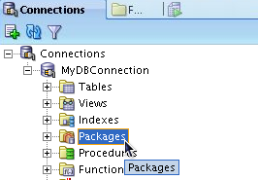
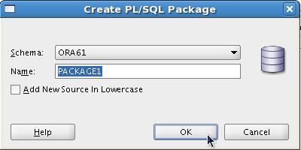
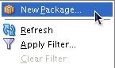
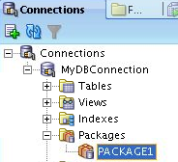
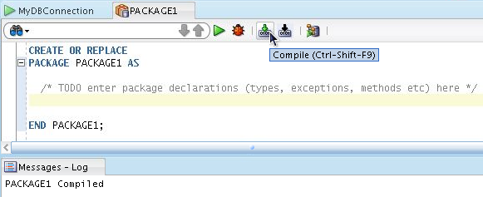
Creating the Package Specification:
Using SQL Developer
3
2
1
5
7
4
Enter package’s declarations
6
Notes:
Oracle Database 11g: Develop PL/SQL Program Units 3 - <number>
Creating the Package Specification: Using SQL Developer
You can use SQL Developer to create the package specification as follows:
1. Right-click the Packages node in the Connections navigation tree.
2. Select New Package from the shortcut menu.
3. In the Create PL/SQL Package window, select the schema name, enter the name for the new package, and then click OK. A tab for the new package is displayed along with the shell for the new package.
4. Enter the code for the new package.
5. Compile or save (using the Save icon on the main toolbar) the new package.
6. The Messages – Log tab displays whether or not the compilation was successful.
7. The newly created package is displayed under the Packages node in the Connections navigation tree.

Slide 13
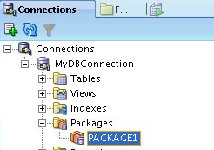
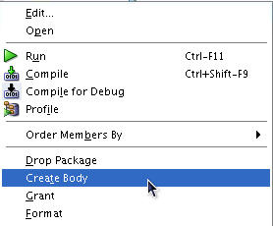
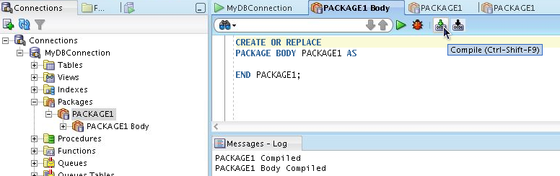
Creating the Package Body: Using SQL Developer
1
2
4
6
3
Enter package’s body code
5
Notes:
Oracle Database 11g: Develop PL/SQL Program Units 3 - <number>
Creating the Package Body: Using SQL Developer
You can use SQL Developer to create the package body as follows:
1. Right-click the package name for which you are creating a body in the Packages node in the Connections navigation tree.
2. Select Create Body from the shortcut menu. A tab for the new package body is displayed along with the shell for the new package body.
3. Enter the code for the new package body.
4. Compile or save the package body.
5. The Messages – Log tab displays whether or not the compilation was successful.
6. The newly created package body is displayed under the Packages node in the Connections navigation tree.

Slide 14
Example of a Package Specification: comm_pkg
-- The package spec with a public variable and a
-- public procedure that are accessible from
-- outside the package.
CREATE OR REPLACE PACKAGE comm_pkg IS
v_std_comm NUMBER := 0.10; --initialized to 0.10
PROCEDURE reset_comm(p_new_comm NUMBER);
END comm_pkg;
/
  V_STD_COMM is a public global variable initialized to 0.10.
  RESET_COMM is a public procedure used to reset the standard commission based on some business rules. It is implemented in the package body.
Notes:
Oracle Database 11g: Develop PL/SQL Program Units 3 - <number>
Example of Package Specification: comm_pkg
The example in the slide creates a package called comm_pkg used to manage business processing rules for commission calculations.
The v_std_comm public (global) variable is declared to hold a maximum allowable percentage commission for the user session, and it is initialized to 0.10 (that is, 10%).
The reset_comm public procedure is declared to accept a new commission percentage that updates the standard commission percentage if the commission validation rules are accepted. The validation rules for resetting the commission are not made public and do not appear in the package specification. The validation rules are managed by using a private function in the package body.

Slide 15
Creating the Package Body
CREATE [OR REPLACE] PACKAGE BODY package_name IS|AS
private type and variable declarations
subprogram bodies
[BEGIN initialization statements]
END [package_name];
  The OR REPLACE option drops and re-creates the package body.
  Identifiers defined in the package body are private and not visible outside the package body.
  All private constructs must be declared before they are referenced.
  Public constructs are visible to the package body.
Notes:
Oracle Database 11g: Develop PL/SQL Program Units 3 - <number>
Creating the Package Body
Create a package body to define and implement all public subprograms and supporting private constructs. When creating a package body, perform the following steps:
Specify the OR REPLACE option to overwrite an existing package body.
Define the subprograms in an appropriate order. The basic principle is that you must declare a variable or subprogram before it can be referenced by other components in the same package body. It is common to see all private variables and subprograms defined first and the public subprograms defined last in the package body.
Complete the implementation for all procedures or functions declared in the package specification within the package body.
The following are definitions of items in the package body syntax:
package_name specifies a name for the package that must be the same as its package specification. Using the package name after the END keyword is optional.
private type and variable declarations declares private variables, constants, cursors, exceptions, user-defined types, and subtypes.
subprogram specification specifies the full implementation of any private and/or public procedures or functions.
[BEGIN initialization statements] is an optional block of initialization code that executes when the package is first referenced.

Slide 16
Example of a Package Body: comm_pkg
CREATE OR REPLACE PACKAGE BODY comm_pkg IS
FUNCTION validate(p_comm NUMBER) RETURN BOOLEAN IS
v_max_comm employees.commission_pct%type;
BEGIN
SELECT MAX(commission_pct) INTO v_max_comm
FROM employees;
RETURN (p_comm BETWEEN 0.0 AND v_max_comm);
END validate;
PROCEDURE reset_comm (p_new_comm NUMBER) IS
BEGIN
IF validate(p_new_comm) THEN
v_std_comm := p_new_comm; -- reset public var
ELSE RAISE_APPLICATION_ERROR(
-20210, 'Bad Commission');
END IF;
END reset_comm;
END comm_pkg;
Notes:
Oracle Database 11g: Develop PL/SQL Program Units 3 - <number>
Example of a Package Body: comm_pkg
The slide shows the complete package body for comm_pkg, with a private function called validate to check for a valid commission. The validation requires that the commission be positive and less than the highest commission among existing employees. The reset_comm procedure invokes the private validation function before changing the standard commission in v_std_comm. In the example, note the following:
The v_std_comm variable referenced in the reset_comm procedure is a public variable. Variables declared in the package specification, such as v_std_comm, can be directly referenced without qualification.
The reset_comm procedure implements the public definition in the specification.
In the comm_pkg body, the validate function is private and is directly referenced from the reset_comm procedure without qualification.
Note: The validate function appears before the reset_comm procedure because the reset_comm procedure references the validate function. It is possible to create forward declarations for subprograms in the package body if their order of appearance needs to be changed. If a package specification declares only types, constants, variables, and exceptions without any subprogram specifications, then the package body is unnecessary. However, the body can be used to initialize items declared in the package specification.

Slide 17
Invoking the Package Subprograms: Examples
-- Invoke a function within the same packages:
CREATE OR REPLACE PACKAGE BODY comm_pkg IS ...
PROCEDURE reset_comm(p_new_comm NUMBER) IS
BEGIN
IF validate(p_new_comm) THEN
v_std_comm := p_new_comm;
ELSE ...
END IF;
END reset_comm;
END comm_pkg;
-- Invoke a package procedure from SQL*Plus:
EXECUTE comm_pkg.reset_comm(0.15)
-- Invoke a package procedure in a different schema:
EXECUTE scott.comm_pkg.reset_comm(0.15)
Notes:
Oracle Database 11g: Develop PL/SQL Program Units 3 - <number>
Invoking Package Subprograms
After the package is stored in the database, you can invoke public or private subprograms within the same package, or public subprograms if external to the package. Fully qualify the subprogram with its package name when invoked externally from the package. Use the package_name.subprogram syntax.
Fully qualifying a subprogram when invoked within the same package is optional.
Example 1: Invokes the validate function from the reset_comm procedure within the same package. The package name prefix is not required; it is optional.
Example 2: Calls the reset_comm procedure from SQL*Plus (an environment external to the package) to reset the prevailing commission to 0.15 for the user session.
Example 3: Calls the reset_comm procedure that is owned by a schema user called SCOTT. Using SQL*Plus, the qualified package procedure is prefixed with the schema name. This can be simplified by using a synonym that references the schema.package_name.
Assume that a database link named NY has been created for a remote database in which the reset_comm package procedure is created. To invoke the remote procedure, use:
EXECUTE comm_pkg.reset_comm@NY(0.15)

Slide 18
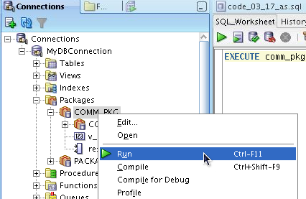
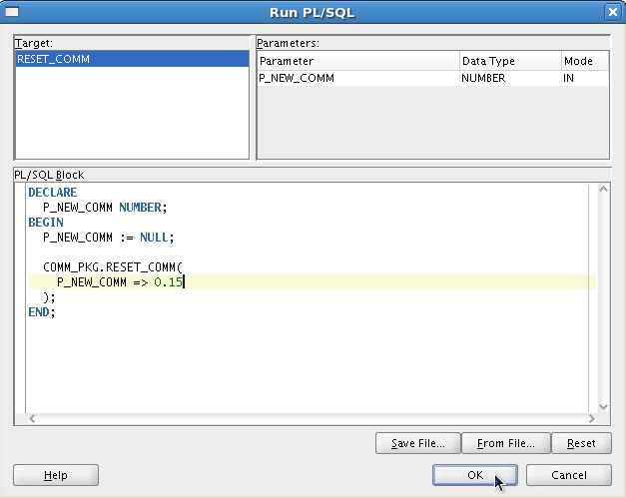
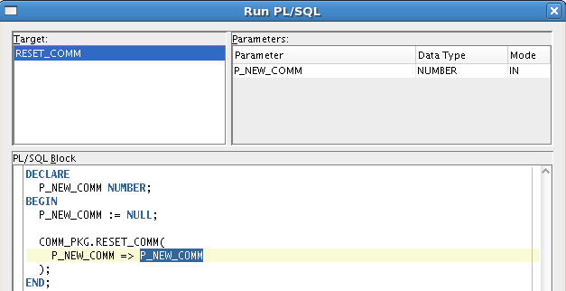
Invoking the Package Subprograms:
Using SQL Developer
1
2
3
4
Notes:
Oracle Database 11g: Develop PL/SQL Program Units 3 - <number>
Invoking the Package Subprograms: Using SQL Developer
You can use SQL Developer to invoke a package's subprogram as follows:
1. Right-click the package's name in the Packages node in the Navigation tree.
2. Select Run from the floating menu. The Run PL/SQL window is displayed. You can use the Run PL/SQL window to specify parameter values for running a PL/SQL function or procedure. (If you specify a package, select a function or procedure in the package.) Specify the following:
a. Target: Select the name of the function or procedure to run.
b. Parameters: This section lists each parameter for the specified target. The mode of each parameter can be IN (the value is passed in), OUT (the value is returned), or IN/OUT (the value is passed in, and the result of the function or procedure's action is stored in the parameter).
3. In the PL/SQL Block section, change the formal IN and IN/OUT parameter specifications in this block to actual values that you want to use for running the function or procedure. For example, to specify 0.15 as the value for an input parameter named P_NEW_COMM, change P_NEW_COMM => P_NEW_COMM to P_NEW_COMM => 0.15.
4. Click OK. SQL Developer runs the function or procedure.

Slide 19
Creating and Using Bodiless Packages
CREATE OR REPLACE PACKAGE global_consts IS
c_mile_2_kilo CONSTANT NUMBER := 1.6093;
c_kilo_2_mile CONSTANT NUMBER := 0.6214;
c_yard_2_meter CONSTANT NUMBER := 0.9144;
c_meter_2_yard CONSTANT NUMBER := 1.0936;
END global_consts;
SET SERVEROUTPUT ON
BEGIN
DBMS_OUTPUT.PUT_LINE('20 miles = ' ||
20 * global_consts.c_mile_2_kilo || ' km');
END;
SET SERVEROUTPUT ON
CREATE FUNCTION mtr2yrd(p_m NUMBER) RETURN NUMBER IS
BEGIN
RETURN (p_m * global_consts.c_meter_2_yard);
END mtr2yrd;
/
EXECUTE DBMS_OUTPUT.PUT_LINE(mtr2yrd(1))
Notes:
Oracle Database 11g: Develop PL/SQL Program Units 3 - <number>
Creating and Using Bodiless Packages
The variables and constants declared within stand-alone subprograms exist only for the duration that the subprogram executes. To provide data that exists for the duration of the user session, create a package specification containing public (global) variables and constant declarations. In this case, create a package specification without a package body, known as a bodiless package. As discussed earlier in this lesson, if a specification declares only types, constants, variables, and exceptions, then the package body is unnecessary.
Examples
The first code box in the slide creates a bodiless package specification with several constants to be used for conversion rates. A package body is not required to support this package specification. It is assumed that the SET SERVEROUTPUT ON statement was issued before executing the code examples in the slide.
The second code box references the c_mile_2_kilo constant in the global_consts package by prefixing the package name to the identifier of the constant.
The third example creates a stand-alone function c_mtr2yrd to convert meters to yards, and uses the constant conversion rate c_meter_2_yard declared in the global_consts package. The function is invoked in a DBMS_OUTPUT.PUT_LINE parameter.
Rule to be followed: When referencing a variable, cursor, constant, or exception from outside the package, you must qualify it with the name of the package.

Slide 20
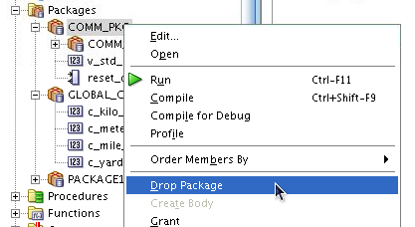
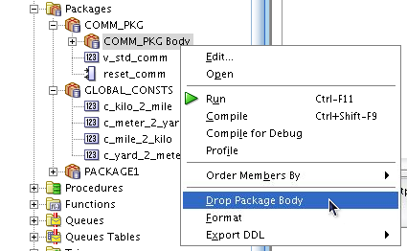
Removing Packages: Using SQL Developer or the SQL DROP Statement
Drop package specification and body
Drop package body only
-- Remove the package specification and body
DROP PACKAGE package_name;
-- Remove the package body only
DROP PACKAGE BODY package_name;
Notes:
Oracle Database 11g: Develop PL/SQL Program Units 3 - <number>
Removing Packages
When a package is no longer required, you can use a SQL statement in SQL Developer to remove it. A package has two parts; therefore, you can remove the whole package, or you can remove only the package body and retain the package specification.

Slide 21
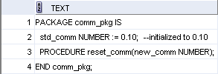
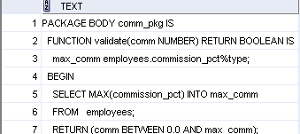
Viewing Packages Using the Data Dictionary
-- View the package specification.
SELECT text
FROM user_source
WHERE name = 'COMM_PKG' AND type = 'PACKAGE'
ORDER BY LINE;
-- View the package body.
SELECT text
FROM user_source
WHERE name = 'COMM_PKG' AND type = 'PACKAGE BODY'
ORDER BY LINE;
Notes:
Oracle Database 11g: Develop PL/SQL Program Units 3 - <number>
Viewing Packages in the Data Dictionary
The source code for PL/SQL packages is also stored in the USER_SOURCE and ALL_SOURCE data dictionary views. The USER_SOURCE table is used to display PL/SQL code that you own. The ALL_SOURCE table is used to display PL/SQL code to which you have been granted the EXECUTE right by the owner of that subprogram code and provides an OWNER column in addition to the preceding columns.
When querying the package, use a condition in which the TYPE column is:
Equal to 'PACKAGE' to display the source code for the package specification
Equal to 'PACKAGE BODY' to display the source code for the package body
You can also view the package specification and body in SQL Developer using the package name in the Packages node.
Note: You cannot display the source code for Oracle PL/SQL built-in packages, or PL/SQL whose source code has been wrapped by using a WRAP utility or obfuscation. Obfuscating and wrapping PL/SQL source code is covered in a later lesson. Clicking the Execute Statement (F9) icon (instead of the Run Script icon) in the SQL Worksheet toolbar, sometimes displays a better formatted output in the Results tab as shown in the slide examples.

Slide 22
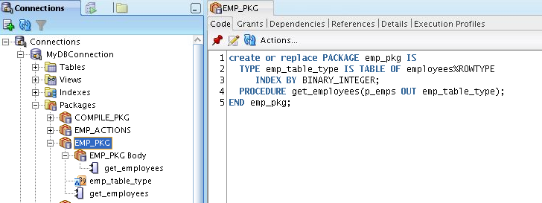
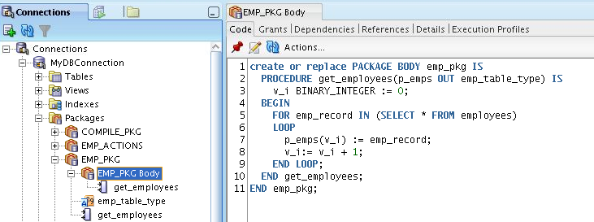
Viewing Packages Using SQL Developer
To view the package spec, click the package name
1
3
2
To view the package body, click the package body
1
3
2
Notes:
Oracle Database 11g: Develop PL/SQL Program Units 3 - <number>
Viewing Packages Using SQL Developer
To view a package's spec in SQL Developer, use the following steps:
1. Click the Packages node in the Connections tab.
2. Click the package's name.
3. The package's spec code is displayed in the Code tab as shown in the slide.
To view a package's body in SQL Developer, use the following steps:
1. Click the Packages node in the Connections tab.
2. Click the package’s body.
3. The package’s body code is displayed in the Code tab as shown in the slide.

Slide 23
Guidelines for Writing Packages
  Develop packages for general use.
  Define the package specification before the body.
  The package specification should contain only those constructs that you want to be public.
  Place items in the declaration part of the package body when you must maintain them throughout a session or across transactions.
  The fine-grain dependency management reduces the need to recompile referencing subprograms when a package specification changes.
  The package specification should contain as few constructs as possible.
Notes:
Oracle Database 11g: Develop PL/SQL Program Units 3 - <number>
Guidelines for Writing Packages
Keep your packages as general as possible, so that they can be reused in future applications. Also, avoid writing packages that duplicate features provided by the Oracle server.
Package specifications reflect the design of your application, so define them before defining the package bodies. The package specification should contain only those constructs that must be visible to the users of the package. Thus, other developers cannot misuse the package by basing code on irrelevant details.
Place items in the declaration part of the package body when you must maintain them throughout a session or across transactions. For example, declare a variable called NUMBER_EMPLOYED as a private variable if each call to a procedure that uses the variable needs to be maintained. When declared as a global variable in the package specification, the value of that global variable is initialized in a session the first time a construct from the package is invoked.
Before Oracle Database 11g, changes to the package body did not require recompilation of dependent constructs, whereas changes to the package specification required the recompilation of every stored subprogram that references the package. Oracle Database 11g reduces this dependency. Dependencies are now tracked at the level of element within unit. Fine-Grain Dependency Management is covered in a later lesson.

Slide 24
Quiz
The package specification is the interface to your applications. It declares the public types, variables, constants, exceptions, cursors, and subprograms available for use. The package specification may also include PRAGMAs, which are directives to the compiler.
  True
  False
Notes:
Oracle Database 11g: Develop PL/SQL Program Units 3 - <number>
Answer: 1

Slide 25
Summary
In this lesson, you should have learned how to:
  Describe packages and list their components
  Create a package to group related variables, cursors, constants, exceptions, procedures, and functions
  Designate a package construct as either public or private
  Invoke a package construct
  Describe the use of a bodiless package
Notes:
Oracle Database 11g: Develop PL/SQL Program Units 3 - <number>
Summary
You group related procedures and functions in a package. Packages improve organization, management, security, and performance.
A package consists of a package specification and a package body. You can change a package body without affecting its package specification.
Packages enable you to hide source code from users. When you invoke a package for the first time, the entire package is loaded into memory. This reduces the disk access for subsequent calls.

Slide 26
Practice 3 Overview:
Creating and Using Packages
This practice covers the following topics:
  Creating packages
  Invoking package program units
Notes:
Oracle Database 11g: Develop PL/SQL Program Units 3 - <number>
Practice 3: Overview
In this practice, you create package specifications and package bodies. You then invoke the constructs in the packages by using sample data.
Note: If you are using SQL Developer, your compile-time errors are displayed in the Message Log tab. If you are using SQL*Plus to create your stored code, use SHOW ERRORS to view compile errors.

